Slide 1
CS F222: Discrete Structures
for
Computer Science
Topic: Set Theory and Functions
Dr. Raghunath Reddy

Slide 2
Introduction to Set Theory
A set is an unordered collection of distinct objects, called elements or members of the set.
Often, but not always, the objects in a set have similar properties.
Many important discrete structures are built using sets, which are collections of objects.
Combinations; unordered collections of objects used extensively in counting;
Relations, sets of ordered pairs that represent relationships between objects;
graphs, sets of vertices and edges that connect vertices; and
finite state machines, used to model computing machines
Notation:
For sets, we’ll use variables S, T, U, … (Upper case letters) For elements, we’ll use variable x, y, z (lower case letters)

Slide 3
Representations of Sets
Roster Method: We can denote a set S in writing by listing all of its elements in curly braces:
{a, b, c} is the set of whatever 3 objects are denoted by a, b, c.
Set builder notation: For any proposition P(x) over any universe of discourse, {x | P(x)} is the set of all x such that P(x).
Ex: O = { x | x is an odd positive number less than 10}

Slide 4
Basic properties of sets
Sets are inherently unordered:
No matter what objects a, b, and c denote, {a, b, c} = {a, c, b} = {b, a, c} = {b, c, a} = {c, a, b} = {c, b, a}.
All elements are distinct (unequal);
multiple listings make no difference!
If a=b, then {a, b, c} = {a, c} = {b, c} = {a, a, b, a, b, c, c, c, c}.
This set contains only 2 elements!

Slide 5
Set Equality
Two sets are equal if and only if they contain exactly the same elements.
In particular, it does not matter how the set is defined or denoted.
For example: The set {1, 2, 3, 4} = {x | x is an integer where x>0 and x<5 } = {x | x is a positive integer whose square is >0 and <25}

Slide 6
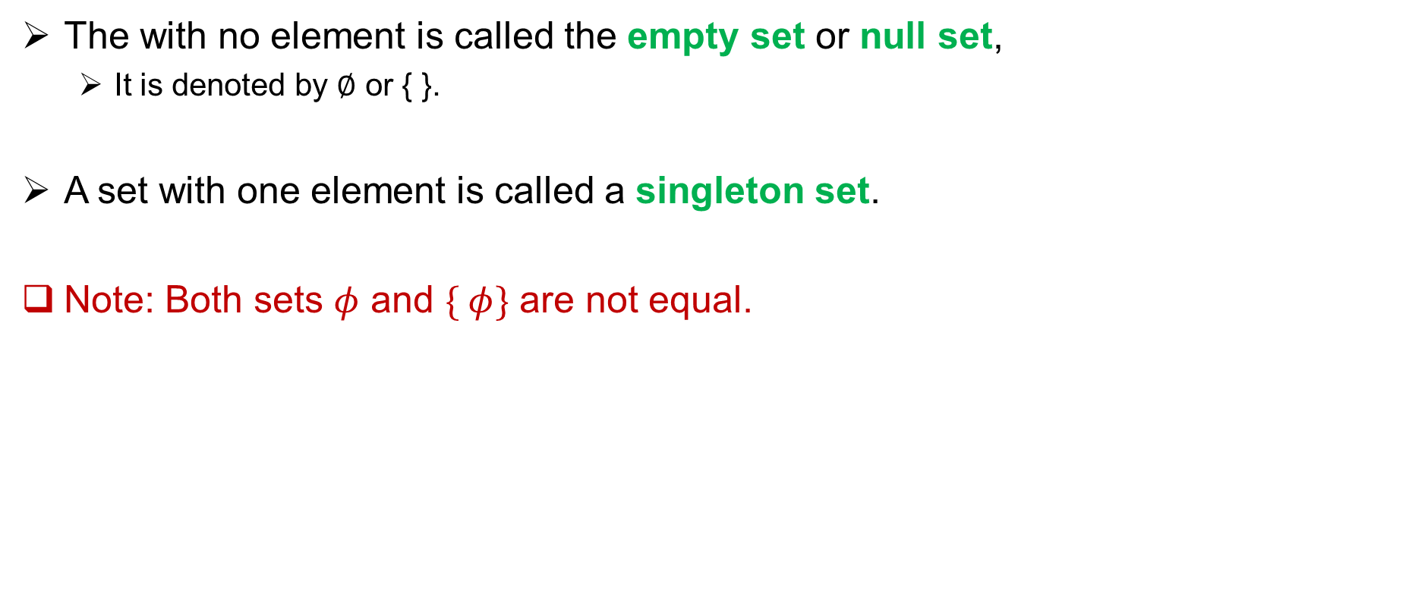
Empty Set and Singleton Set
The with no element is called the empty set or null set,
It is denoted by ∅ or { }.
A set with one element is called a singleton set.
Note: Both sets $φ$ and $\{ φ\}$ are not equal.

Slide 7
Basic Set Relations: Member of
a ∈ A : a is an element of the set A. a ∉ A : a is not an element of the set A.
Remark: We can define set equality in terms of ∈ relation:
∀S,T: S=T ↔ (∀x: x∈S ↔ x∈T)
Venn diagram:

Slide 8
Subset and Superset Relations
The set A is a subset of B, (and B is a superset of A),
if and only if every element of A is also an element of B.
Notation A ⊆ B to indicate that A is a subset of the set B and, B ⊇ A denotes B is a superset of A
S⊆T ⇔ ∀x (x∈S → x∈T)
Results: For any set S, ∅⊆S and S⊆S.
Notes:
Discrete Mathematics and its Applications
9/9/2021
(c)2001-2002, Michael P. Frank
8

Slide 9
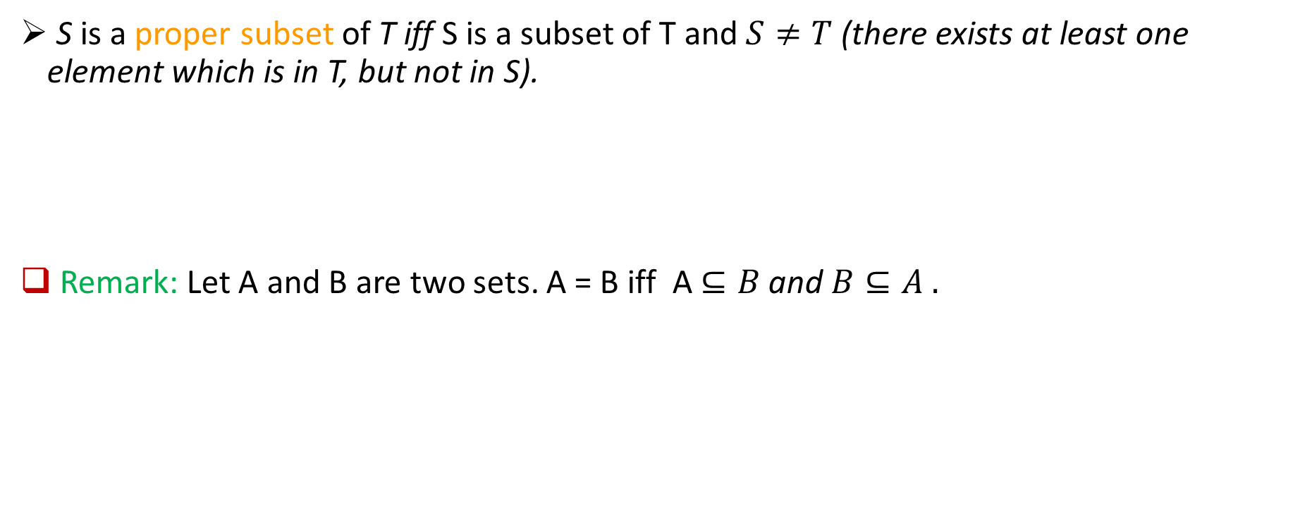
Proper (Strict) Subsets
S is a proper subset of T iff S is a subset of T and $S≠T$ (there exists at least one element which is in T, but not in S).
Remark: Let A and B are two sets. A = B iff A $⊆B$ and $B⊆A .$
Notes:
Discrete Mathematics and its Applications
9/9/2021
(c)2001-2002, Michael P. Frank
9

Slide 10
Sets as Objects
Sets may have other sets as members.
For instance, we have the sets
A = {∅, {a}, {b}, {a, b}} and B = {x ∣ x is a subset of the set {a, b}}.
Note that a ≠ {a} ≠ {{a}} !!!!
Notes:
Discrete Mathematics and its Applications
9/9/2021
(c)2001-2002, Michael P. Frank
10

Slide 11
Cardinality and Finiteness
|S| (read “the cardinality of S”) is a measure of how many different elements S has.
E.g., |∅|=0, |{1,2,3}| = 3, |{a,b}| = 2,
|{{1,2,3},{4,5}}| = ____
If |S | is a non-negative integer, then we say S is finite. Otherwise, we say S is infinite.

Slide 12
Power set
The power set P(S) of a set S is the set of all subsets of S. P(S) :≡ {x | x⊆S}.
Sometimes P(S) is written 2^{S}.
E.g. P({a,b}) = {∅, {a}, {b}, {a,b}}.
What is the power set of empty set ?
Let |S|=n, then the size of the power set of S is ……………

Slide 13
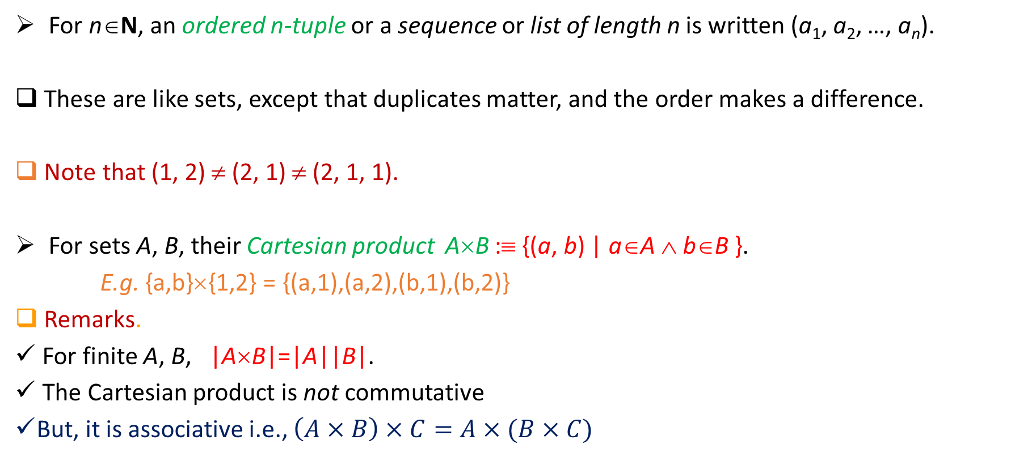
Ordered n-tuples and Cartesian Product
For n∈N, an ordered n-tuple or a sequence or list of length n is written (a₁, a₂, …, a_{n}).
These are like sets, except that duplicates matter, and the order makes a difference.
Note that (1, 2) ≠ (2, 1) ≠ (2, 1, 1).
For sets A, B, their Cartesian product A×B :≡ {(a, b) | a∈A ∧ b∈B }.
E.g. {a,b}×{1,2} = {(a,1),(a,2),(b,1),(b,2)}
Remarks.
For finite A, B, |A×B|=|A||B|.
The Cartesian product is not commutative
But, it is associative i.e., $\left(A×B\right)×C=A×(B×C)$
Notes:
Discrete Mathematics and its Applications
9/9/2021
(c)2001-2002, Michael P. Frank
13

Slide 14
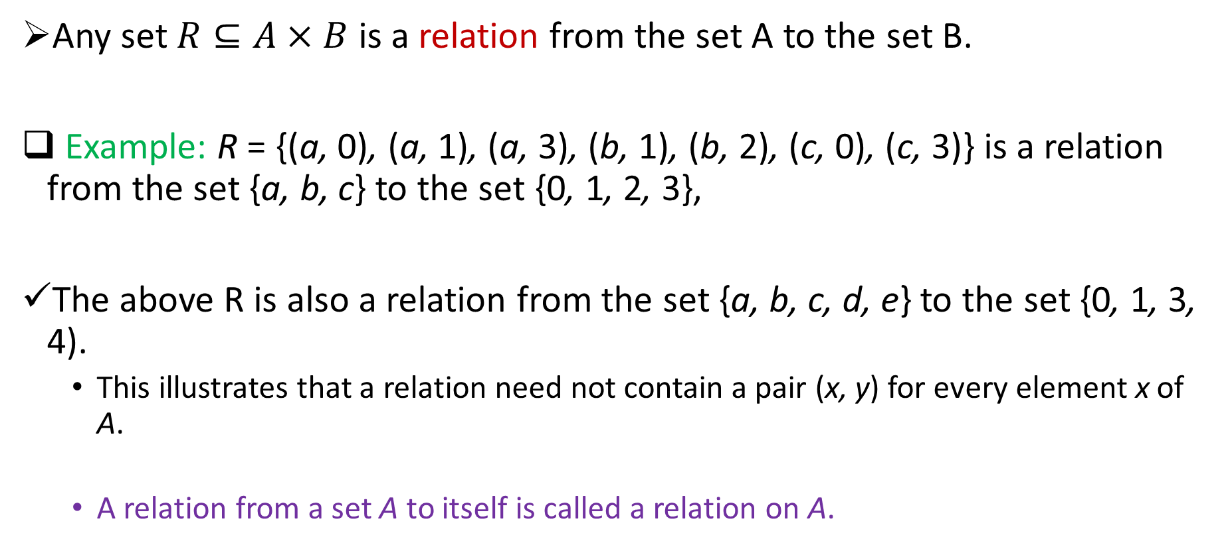
Relations
Any set $R⊆A×B$ is a relation from the set A to the set B.
Example: R = {(a, 0), (a, 1), (a, 3), (b, 1), (b, 2), (c, 0), (c, 3)} is a relation from the set {a, b, c} to the set {0, 1, 2, 3},
The above R is also a relation from the set {a, b, c, d, e} to the set {0, 1, 3, 4).
This illustrates that a relation need not contain a pair (x, y) for every element x of A.
A relation from a set A to itself is called a relation on A.

Slide 15
Few more examples

Slide 16
Set Operators

Slide 17
Union
For sets A, B, their ∪nion A∪B is the set containing all elements that are in A, or in B (or, of course, in both).
Formally, ∀A,B: A∪B = {x | x∈A ∨ x∈B}.
Remark. A∪B is a superset of both A and B
∀A, B: (A∪B ⊇ A) ∧ (A∪B ⊇ B)
Examples:
{a,b,c} ∪ {2,3} = {a,b,c,2,3}
{2,3,5}∪{3,5,7} = {2,3,5,3,5,7} ={2,3,5,7}

Slide 18
Intersection
For sets A, B, their intersection A∩B is the set containing all elements that are in both A and (“∧”) in B.
Formally, ∀A,B: A∩B={x | x∈A ∧ x∈B}.
Remark. A∩B is a subset of both A and B
∀A, B: (A∩B ⊆ A) ∧ (A∩B ⊆ B)
Examples:
{a,b,c}∩{2,3} = ___
{2,4,6}∩{3,4,5} = ______
Two sets A, B are called disjoint (i.e., unjoined) iff their intersection is empty i.e., (A∩B=∅).

Slide 19
How many elements are in A∪B?
|A∪B| = |A| + |B| − |A∩B|
Subtract out items
in intersection, to
compensate for
double-counting them!
Notes:
Discrete Mathematics and its Applications
9/9/2021
(c)2001-2002, Michael P. Frank
19

Slide 20
Set Difference
For sets A, B, the difference of A and B, written A−B, is the set of all elements that are in A but not B.
( Also called: The complement of B with respect to A.)
Formally: A − B :≡ {x | x∈A ∧ x∉B}
Example: {1,2,3,4,5,6} − {2,3,5,7,9,11} =
Notes:
Discrete Mathematics and its Applications
9/9/2021
(c)2001-2002, Michael P. Frank
20

Slide 21
Set Complements
The universe of discourse can itself be considered a set, call it U.
When the context clearly defines U, we say that for any set A⊆U
The complement of A, written , is the complement of A w.r.t. U, i.e., it is U−A.
E.g., If U=N,

Slide 22
Set Identities
How to prove the set identities:
Let E₁ = E₂ (where the Es are set expressions)
Prove E₁ ⊆ E₂ and E₂ ⊆ E₁ separately.
Identity: A∪∅ = A = A∩U
Domination: A∪U = U , A∩∅ = ∅
Idempotent: A∪A = A = A∩A
Double complement:
Commutative: A∪B = B∪A , A∩B = B∩A
Associative: A∪(B∪C)=(A∪B)∪C , A∩(B∩C)=(A∩B)∩C
De Moran’s Law:

Slide 23
Show that A∩(B∪C)=(A∩B)∪(A∩C).
Part 1: Show A∩(B∪C)⊆(A∩B)∪(A∩C).
Assume x∈A∩(B∪C), & show x∈(A∩B)∪(A∩C).
We know that x∈A, and x∈B or x∈C.
Case 1: x∈B. Then x∈A∩B, so x∈(A∩B)∪(A∩C).
Case 2: x∈C. Then x∈A∩C , so x∈(A∩B)∪(A∩C).
Therefore, x∈(A∩B)∪(A∩C).
Therefore, A∩(B∪C)⊆(A∩B)∪(A∩C).
Part 2: Show (A∩B)∪(A∩C) ⊆ A∩(B∪C). …

Slide 24
Generalized Unions & Intersections
Since union & intersection are commutative and associative, we can extend them from operating on ordered pairs of sets (A,B) to operating on sequences of sets (A₁,…,A_{n})

Slide 25
Generalized Union
Binary union operator: A∪B
n-ary union: A∪A₂∪…∪A_{n} :≡ ((…((A₁∪ A₂) ∪…)∪ A_{n}) (grouping & order is irrelevant)
“Big U” notation:
or for infinite sets of sets:

Slide 26
Generalized Intersection
Binary intersection operator: A∩B
n-ary intersection: A₁∩A₂∩…∩A_{n}≡((…((A₁∩A₂)∩…)∩A_{n}) (grouping & order is irrelevant)
“Big Arch” notation:
or for infinite sets of sets:

Slide 27
Computer Representations of Sets
For an enumerable u.d. U with ordering x₁, x₂, …, represent a finite set S⊆U as the finite bit string B=b₁b₂…b_{n} where ∀i: x_{i}∈S ↔ (i<n ∧ b_{i}=1).
E.g. U=N, S={2,3,5,7,11}, B=001101010001.
In this representation, the set operators “∪”, “∩”, “‾ “ are implemented directly by bitwise OR, AND, NOT, respectively!
Notes:
Discrete Mathematics and its Applications
9/9/2021
(c)2001-2002, Michael P. Frank
27

Slide 28
Thank You!!

